Slide 1
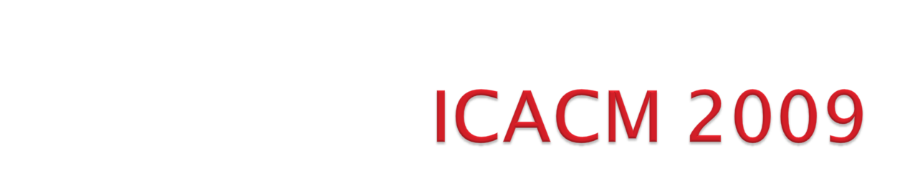
Status Update
8 October 2008

Slide 2

Background of ICACM
ICACM 2009
  Details (dates, funding, etc)
  Topics
  Committees
  Tentative list of speakers
Discussion

Slide 3

Objective: promote research partnership between US & FR in applied computational mechanics
Initial discussions: 2005
ICACM symposia
  2007: Bridging Scales in Computation (UF-REEF, Shalimar, FL, US)
  2008: Materials under extreme loadings (DGA, Rocamadour, FR)
  2009: Damage and fracture in heterogeneous materials and structures (UF-REEF, US)
  2010: Topic and specific location to be determined by FR (Paris XIII, FR)
  2011: Joint IUTAM/ICACM Symposium on Multi-scale modeling (UF/REEF, US) – need to consider approach.

Slide 4

1st US-FR Symposium:
Advances in Bridging Scales in Computation From Microstructure to Macro-Scale Properties of Heterogeneous Materials, March 28-30, 2007 - Shalimar, FL
• Funding: AFOSR (Computational Mathematics)
• 40 participants, 2/3 French
• 28 presentations, 12 keynote speakers, 10 US presentations
• 90% of participants were speakers:
• Keynote speakers: 45 minutes
• Invited speakers: 30 minutes
• Registration, welcome reception, banquet, breakfast, lunch,
lodging: free for FR participants only

Slide 5


ICACM 2007 Book: Multiscale Modeling of Heterogenous Materials
From microstructure to macro-scale properties
Overview of recent advances in
computational methods for linking phenomena
in systems that span large ranges of time and
spatial scales.
Contents: selected papers presented at ICACM 2007
ISBN: 9781848210479
Publication Date: August 2008 Hardback 368 pp.
70.00 GBP, 110.00 EUR, 140.00 USD
To order: http://www.iste.co.uk/index.php?a=i&ACTION=Static&Page=ordering
Authors are entitled to 30% discount

Slide 6

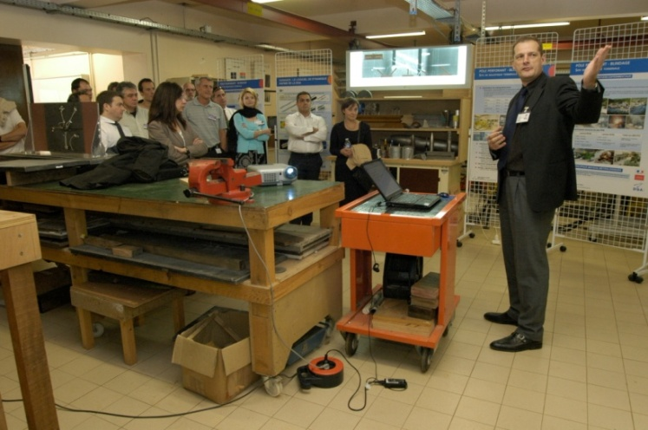
2nd US-FR Symposium:
MATERIALS UNDER EXTREME LOADINGS - APPLICATION
TO PENETRATION AND IMPACT
28-30 May 2008 Hôtel du Château Rocamadour,
France
Funding: DGA/UM-MID + CNRS + DYMAT
61 participants, 1/3 US
29 presentations, 10 keynote speakers, 17 US talks
90% of participants were speakers:
Keynote speakers: 40 minutes
• Invited speakers: 25 minutes
• Registration, welcome reception, banquet, breakfast, lunch, lodging: free
ICACM 2008 CD-ROM containing: list of participants, all presentations, photos
ICACM 2008: BOOK (to be discussed)

Slide 7

Title:
DAMAGE AND FAILURE IN HETEROGENEOUS MATERIALS AND STRUCTURES
22 – 24 April 2009, UF-REEF, Shalimar, Florida
60 participants, 2/3 FR, by invitation only
24 presentations, 10 keynote speakers, 7 US talks
Funding: AFOSR/AFRL
Keynote speakers: 40 minutes
• Invited speakers: 25 minutes
• Registration, welcome reception, banquet, breakfast, lunch, lodging: free for FR participants
Other: Website, poster NLT 90 days prior
Proposal presentation to the ICACM executive advisory board: 26 September 2008
Notes:
$300 registration fee to cover banquet, reception, 3 lunches, 3 breakfasts, snacks.
Lodging for French speakers to be covered by US (4 nights).
Need $ for DOCE fee.

Slide 8
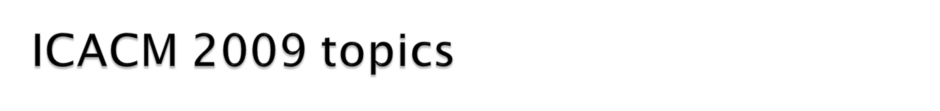
Ductile damage
Ductile damage at ambient temperatures and quasi-static loadings
novel developments in experimental identification and characterization of dissipative mechanisms ; bridging scales techniques: (Homogenization methods, FE based methods; novel limit analysis methods) ; strain rate effects; texture effects
Fatigue damage
Damage in geomaterials
Micromechanics of porous media with evolving microstructure and modeling of the related transport properties
Instabilities, bifurcation phenomena
Chemo-mechanical damage
Degradation due to chemical agents
Impact on durability of materials and structures

Slide 9

Proposed Scientific committee
Dr. R. Dormeval, Fr, CEA, DYMAT, FR
Dr. Eric Buzaud, DGA
Dr. R.A. Lebensohn, Los Alamos National Lab, AFRL, US
Dr. F. Darve, Univ Joseph Fourier, FR
Dr. D. Kondo, Univ Lille, FR
Dr. P. Franciosi, Univ. Paris XIII, FR
Dr. M. Schmidt, AFRL, USA
Dr. O. Cazacu,Univ Florida, USA
Local organizing committee:
Dr. J. Rogacki, Dr. O. Cazacu, J. Lusk

Slide 10

1 | P. Suquet | Lab de Mecanique et d’Acoustique (LMA), CNRS, Marseille, FR
2 | J-B Leblond | Lab modelisation en Mecanique, (LMM), Paris Vi, FR
3 | P. Gilormini | Ecole Nationale Superieure d’Arts et Metiers, (ENSAM) Paris, FR
4 | F. Darve | Lab 3S-R, Grenoble, FR
5 | D. Kondo | Univ Lille, FR
6 | J. Besson | Ecole de Mines Paris, (EMP), FR
7 | J-L Chaboche | ONERA
8 | P. Ponte-Castaneda | Univ. Pennsylvania US
9 | C. N. Tome | Los Alamos, US
10 | J.Y. Yoon | Alcoa, US

Slide 11
11 | S. Gosh | Ohio State Univ, US
12 | N. Triantafyllidis | Univ Michigan, US
13 | V. Monchiet | Univ Marne-la Valee, FR
14 | E. Darve | Stanford Univ, US
15 | A. Constantinescu | LMS, FR
16 | J.W. JU | UCLA, US
17 | E. Maire | Ecole de Mines Paris, (EMP), FR
18 | J. Desrues | CNRS, Lab 3S-R, Grenoble, FR
19 | M. Bornert | LMS
20 | A. Benzerga | Texas A & M, US
21 | G. Kaschner | Los Alamos, US

Slide 12
22 | G. Pijaudier-Cabot | Pau
23 | L Dormieux | ENPC
24 | JJ Marigo | Paris Vi
25 | F. Hild | LMT
26 | N. Moes | Nantes
27 | F. Morel | Univ Anger
28 | J. Pastor | Chambery
29 | A. Chrysochos | Montpellier
30 | E. Charkaluk | Lille
31 | A. Delaplace | LMT Cachan
32 | F. Radjai | Montpellier

Slide 13
33 | S. Li | UC Berkeley

Slide 14
DISCUSSION

Slide 15

Send recommendations regarding additional keynote and invited speakers to O. Cazacu by 3 October (ALL)
Send recommendations regarding scientific committee members to O. Cazacu by 3 October (ALL)
Send updated information to scientific committee by 10 October (Prof Cazacu)
Initiate process to publish book (IST – Wiley publisher) from ICACM 2 (E. Buzaud)
Contact invited & keynote speakers for ICACM 3 by 31 October and report results to O. Cazacu (As designated)
Propose to IUTAM leadership that we have a joint IUTAM/ICACM symposium (O. Cazacu, et al - Feb 09/once ICACM 3 website is up and running). Offer to work within their guidelines, help with funding support. (Discuss results at ICACM 3).
Discuss how we will integrate ICACM 4 with World Congress in Paris, June 2010. (All – ICACM 3).
Investigate EOARD funding for workshops and participants of future workshops (31 October – F. Fahroo, J. Rogacki).

